Slide 1

PROJECT-P339 HOTEL RATING CLASSIFICATION
Group 2:
Group Members:
MR. ARUN KUMAR UDAY PRATAP SINGH
MR. BHARATH THORLIKONDA
MR. HAVISHMAN SHIVAJI GHATGE MS. KIRTEE SHIRSAT MR. NIMISH RANADE
MS. RAKSHA SUBHASH KALE
MS. RIFATH YASMEEN

Slide 2

OBJECTIVE:
This is a Classification Project. Our goal is to examine how travelers are communicating their positive and negative experiences in online platforms for staying in a specific hotel and major objective is what are the attributes that travelers are considering while selecting a hotel.
With this, the manager can understand which elements of their hotel influence more in forming a positive review or improves hotel brand image.

Slide 3
PROJECT FLOW
Understanding The Business Objective
Data Collection
EDA
Model Building
Model Evaluation
Model Deployment

Slide 4
EXPLORATORY DATA ANALYSIS

Slide 5
Data Set Details:
Shape of the dataset is 20491 Rows ,2 Columns.
The two features are “Reviews” and “Ratings”.
Reviews Feature contain categorical values and it is a “object” Datatype.
Ratings Feature contain numerical values and it is a “float64” Datatype.
There are No null or missing values.
No outliers in data.

Slide 6
DATA VISUALIZATION

Slide 7
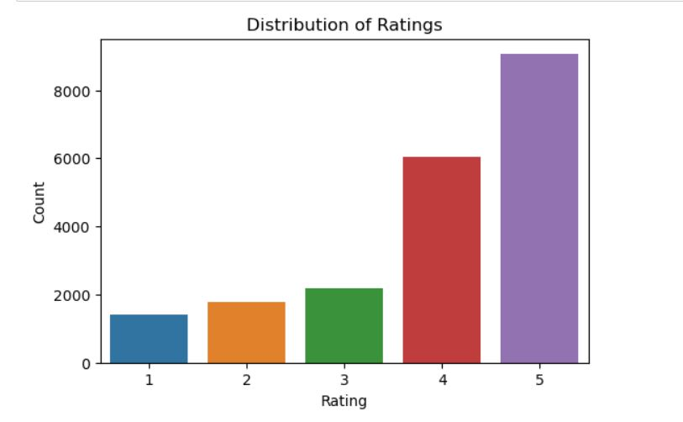
HISTOGRAM
Here it is found that the given Data Set have more reviews with Rating 5 as compared with the reviews with rest of the ratings.

Slide 8
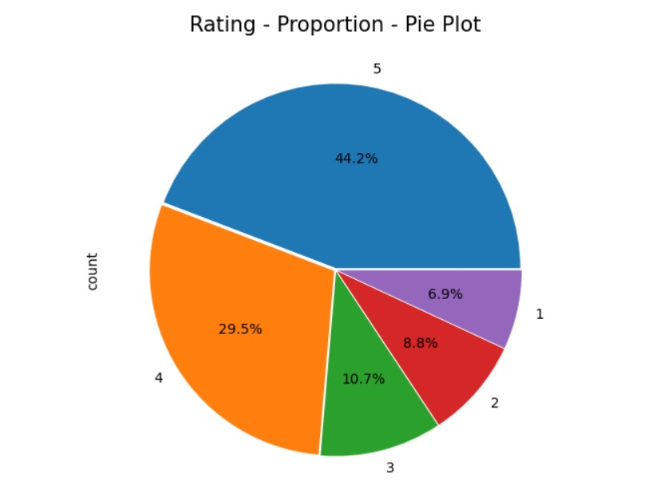
Pie Plot
By looking in to the plots plotted it is found that the major portion reviews in the Data Set are Good Reviews (i.e., 4 & 5).

Slide 9
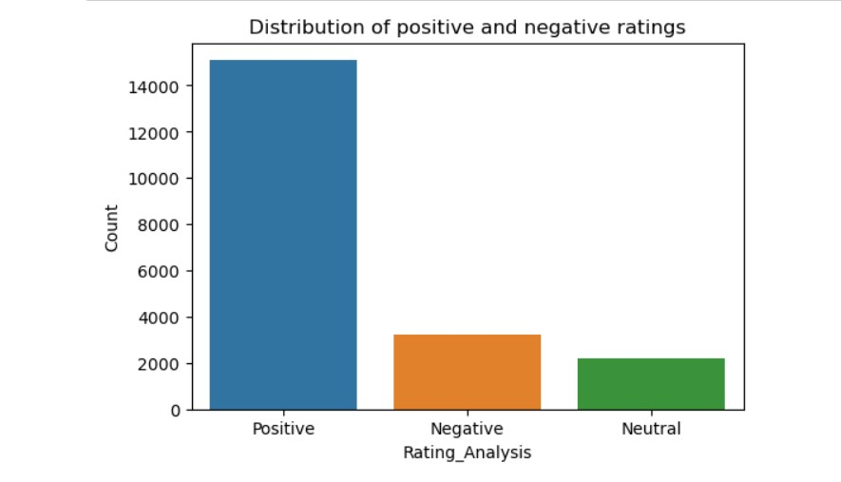
HISTOGRAM Distribution of ratings: Positive, Negative and Neutral

Slide 10
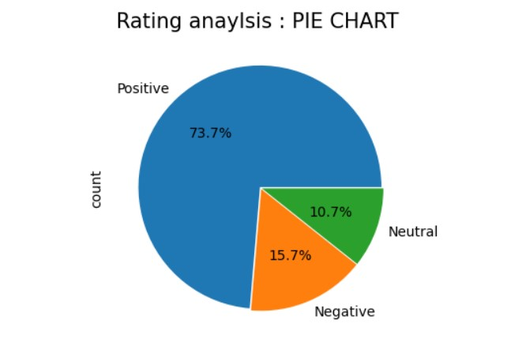
PIE PLOT: Positive, Negative and Neutral Ratings

Slide 11
PRE-PROCESSING STEPS:
Cleaning the data by removing punctuations, hashtags, RH, urls, tags from the data.
Removing Stop words.
Reducing words to their root form through Lemmatization.
Finding Polarity and subjectivity of the words to understand the sentiment behind it.

Slide 12
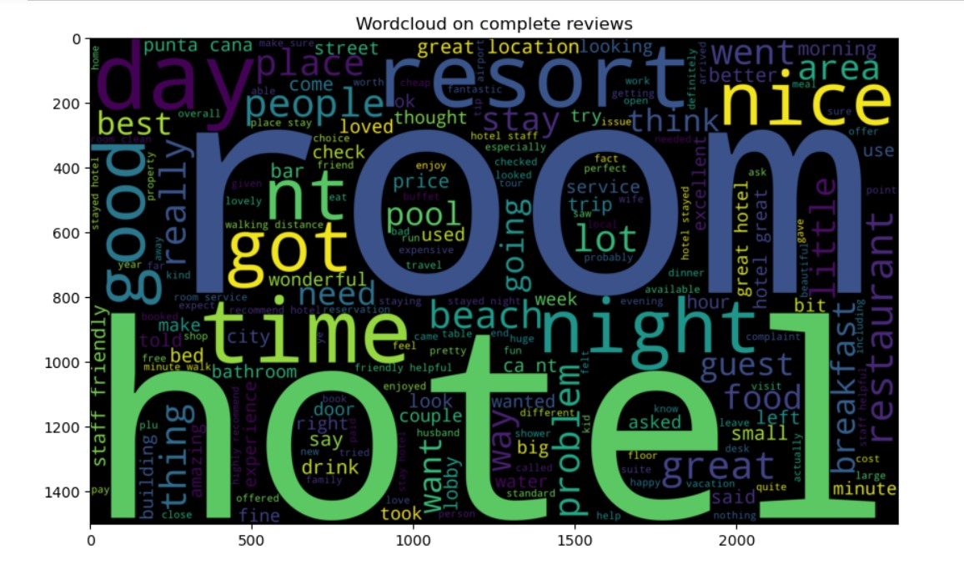
WORD CLOUD
Most of the words are indeed related to the customer experience with the hotel stay: great, nice, awesome, good, expensive etc.
Some words are related to the hotels: hotel, rooms, parking etc.

Slide 13
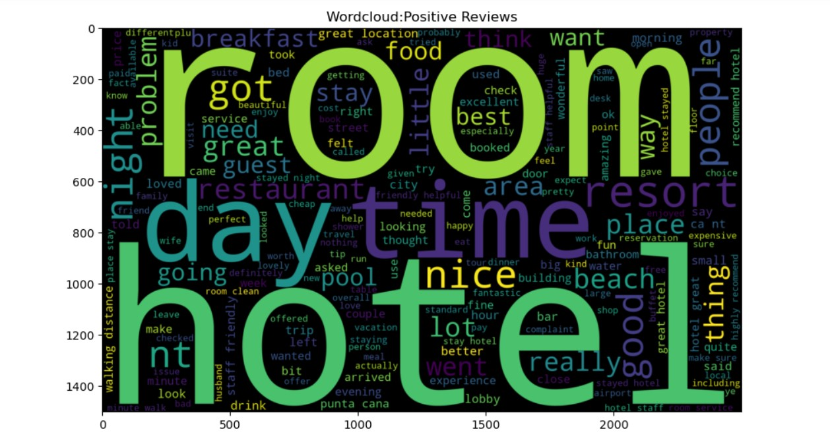
Word Cloud of Positive Reviews

Slide 14
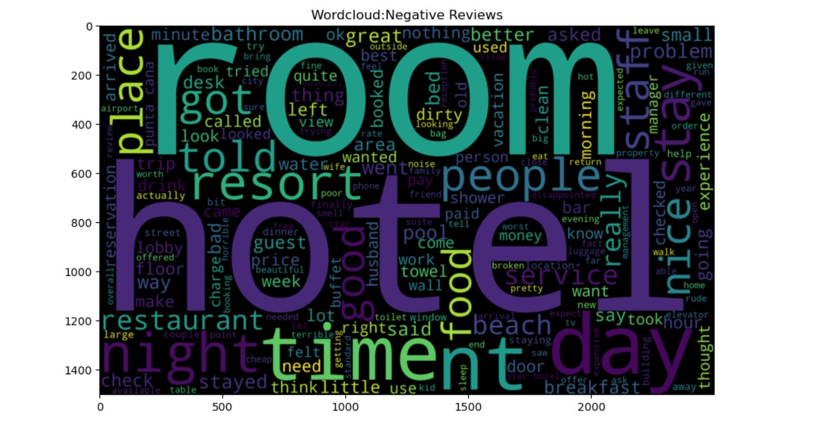
Word Cloud of Negative Reviews

Slide 15
n-gram analysis
Bigram rating counts for 4 and 5
For rating 4
[('great location', 845),
('staff friendly', 763),
('punta cana', 565),
('walking distance', 528),
('friendly helpful', 503),
('staff helpful', 416),
('good value', 414),
('stayed nights', 409),
('minute walk', 402),
('great time', 401)]
For rating 5
[('great location', 1014),
('staff friendly', 1013),
('friendly helpful', 777),
('highly recommend', 736),
('walking distance', 735),
('punta cana', 603),
('staff helpful', 540),
('place stay', 540),
('stayed nights', 511),
('minute walk', 511)]

Slide 16
Tri gram rating counts for 4 and 5
For rating 4
[('staff friendly helpful', 298),
('good value money', 125),
('10 minute walk', 99),
('great place stay', 98),
('flat screen tv', 89),
('easy walking distance', 85),
('la carte restaurants', 85),
('king size bed', 73),
('staff helpful friendly', 68),
('free internet access', 68)]
For rating 5
[('staff friendly helpful', 403),
('great place stay', 169),
('flat screen tv', 151),
('king size bed', 114),
('10 minute walk', 114),
('staff helpful friendly', 104),
('great location great', 100),
('free internet access', 100),
('easy walking distance', 96),
('staff extremely helpful', 94)]

Slide 17
Check for common words in highest rated reviews
{'great location',
'punta cana',
'staff friendly',
'stayed nights',
'walking distance’}
Check for common words in least rated reviews
{'punta cana', 'san juan'}

Slide 18
LEMMATIZATION
After applying lemmatization ;
Number of characters have been reduced from 655 to 623
Number of words in review has been retained
They are converted to their base/root/stem/words

Slide 19
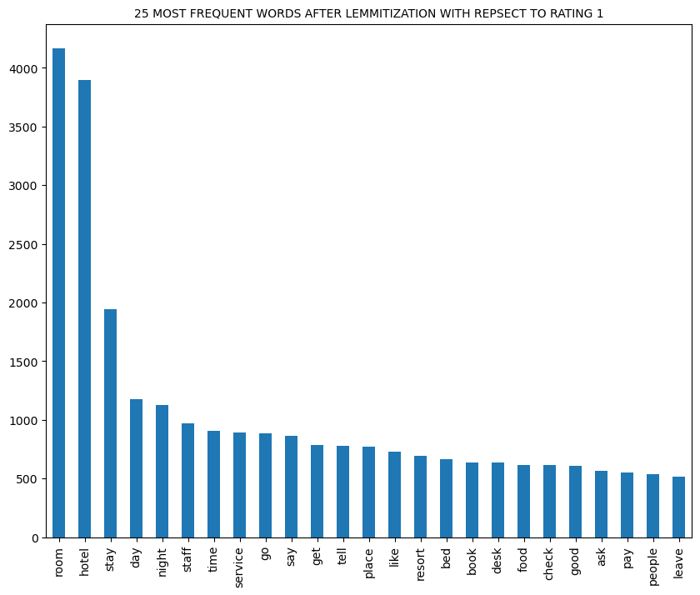

Slide 20
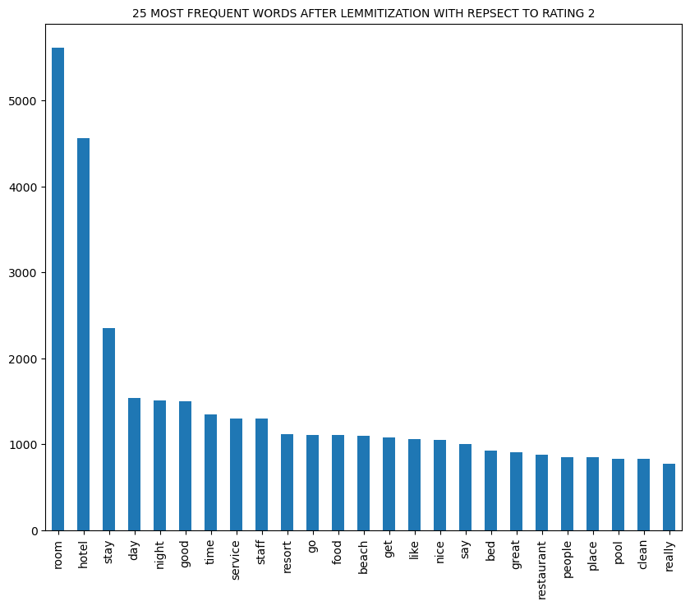

Slide 21
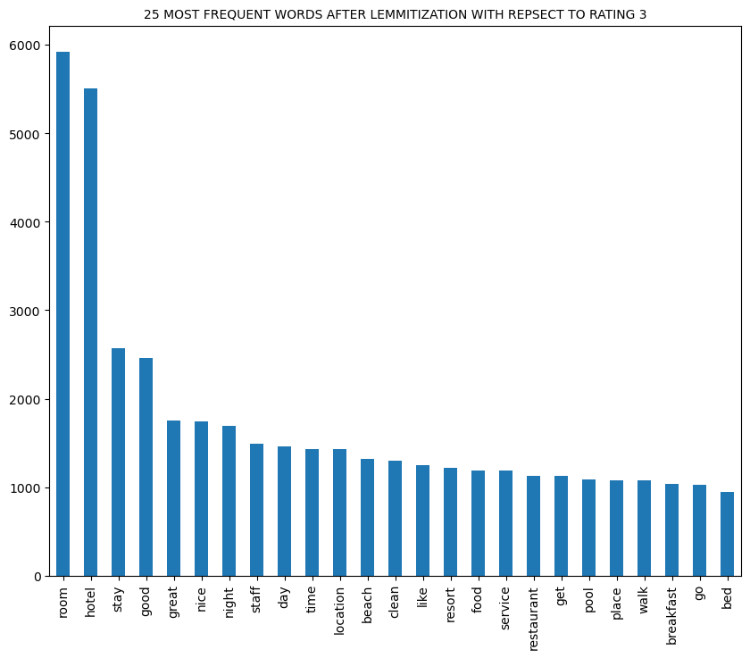

Slide 22
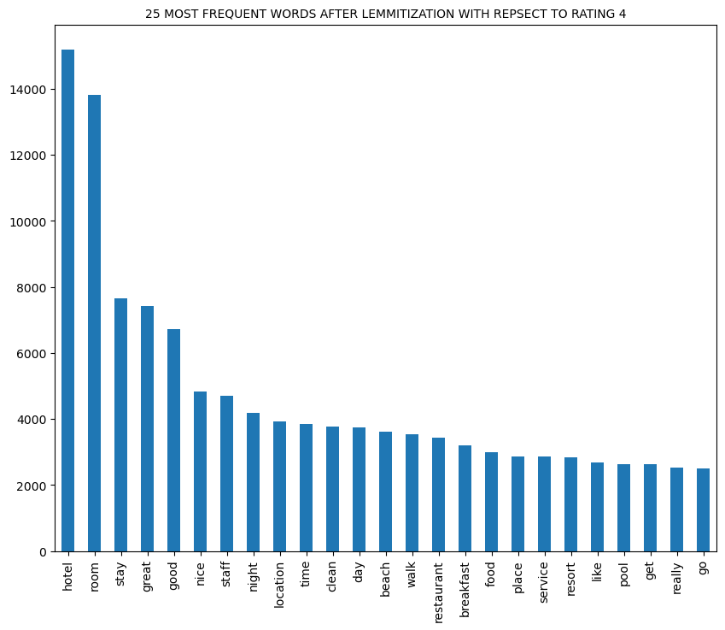

Slide 23
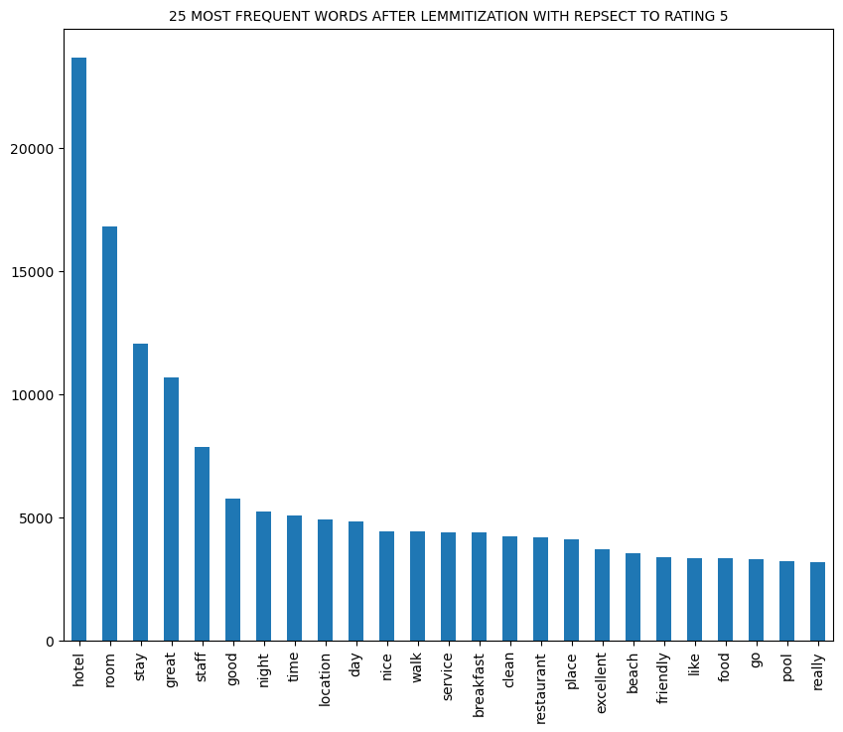

Slide 24
MODEL BUILDING
Using TF-IDF Data is converted into structured numerical format.

Slide 25
1.Decision Tree Classifier:
Accuracy of train dataset is 1.0
Accuracy of test dataset is 0.939
2.Logistic Regression Model:
Accuracy of train dataset is 0.974
Accuracy of test dataset is 0.964
3.Random Forest Classifier:
Accuracy of train dataset is 0.999
Accuracy of test dataset is 0.951
4.SVM-Support Vector Machine
Accuracy of train dataset is 0.996
Accuracy of test dataset is 0.959

Slide 26
THANK YOU

